Slide 1
Discrete Probability Distributions
6
Notes:
‹#›

Slide 2
GOALS
Define the terms probability distribution and random variable.
Distinguish between discrete and continuous probability distributions.
Calculate the mean, variance, and standard deviation of a discrete probability distribution.
Describe the characteristics of and compute probabilities using the binomial probability distribution.
Describe the characteristics of and compute probabilities using the hypergeometric probability distribution.
Describe the characteristics of and compute probabilities using the Poisson probability distribution.
Notes:
‹#›

Slide 3
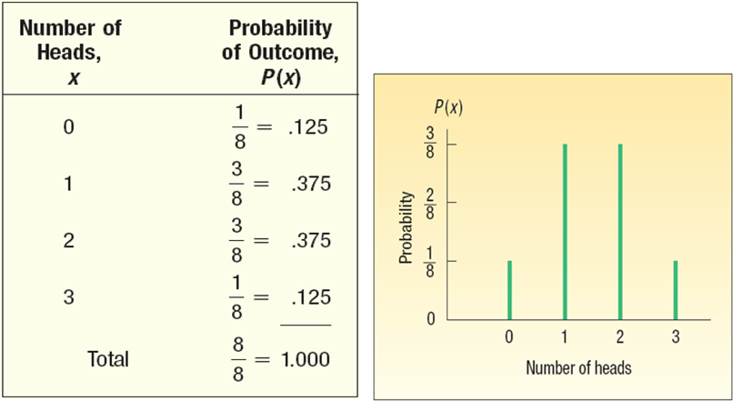
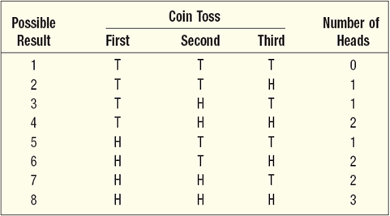
What is a Probability Distribution?
PROBABILITY DISTRIBUTION A listing of all the outcomes of an experiment and the probability associated with each outcome.
CHARACTERISTICS OF A PROBABILITY DISTRIBUTION
The probability of a particular outcome is between 0 and 1 inclusive.
The outcomes are mutually exclusive events.
The list is exhaustive. So the sum of the probabilities of the various events is equal to 1.
Experiment:
Toss a coin three times. Observe the number of heads. The possible results are: Zero heads, One head, Two heads, and Three heads.
What is the probability distribution for the number of heads?
Notes:
‹#›

Slide 4
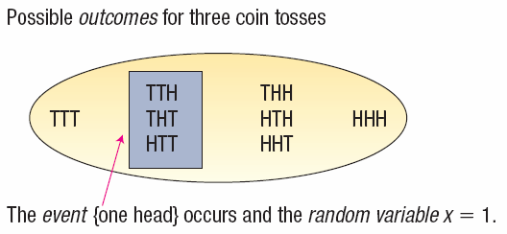
Random Variables
RANDOM VARIABLE A quantity resulting from an experiment that, by chance, can assume different values.
CONTINUOUS RANDOM VARIABLE can assume an infinite number of values within a given range. It is usually the result of some type of measurement
DISCRETE RANDOM VARIABLE A random variable that can assume only certain clearly separated values. It is usually the result of counting something.
EXAMPLES
The number of students in a class.
The number of children in a family.
The number of cars entering a carwash in a hour.
Number of home mortgages approved by Coastal Federal Bank last week.
EXAMPLES
The length of each song on the latest Tim McGraw album.
The weight of each student in this class.
The temperature outside as you are reading this book.
The amount of money earned by each of the more than 750 players currently on Major League Baseball team rosters.
Notes:
‹#›

Slide 5
The Mean and Variance of a Discrete Probability Distribution
MEAN
The mean is a typical value used to represent the central location of a probability distribution.
The mean of a probability distribution is also referred to as its expected value.
VARIANCE AND STANDARD DEVIATION
Measures the amount of spread in a distribution
The computational steps are:
1. Subtract the mean from each value, and square this difference.
2. Multiply each squared difference by its probability.
3. Sum the resulting products to arrive at the variance.
The standard deviation is found by taking the positive square root of the variance.
Notes:
‹#›

Slide 6
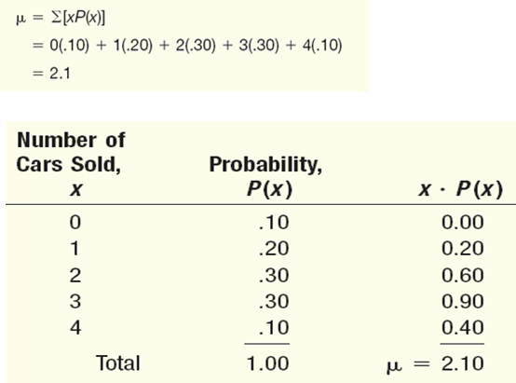
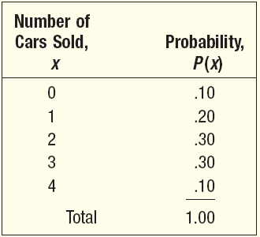

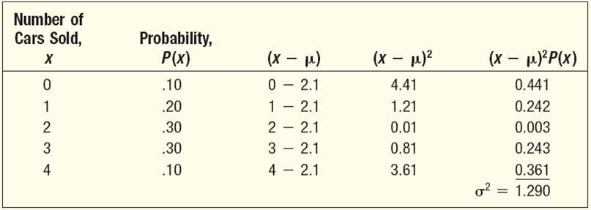
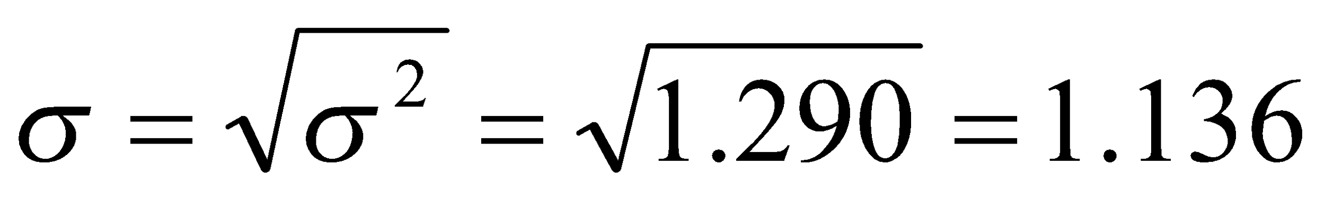
Mean, Variance, and Standard Deviation of a Probability Distribution - Example
John Ragsdale sells new cars for Pelican Ford. John usually sells the largest number of cars on Saturday. He has developed the following probability distribution for the number of cars he expects to sell on a particular Saturday.
MEAN
VARIANCE
STANDARD
DEVIATION
Notes:
‹#›

Slide 7
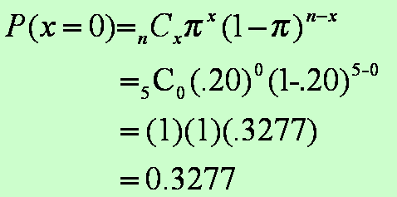
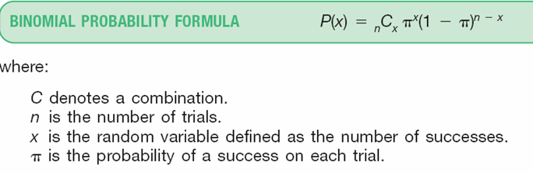
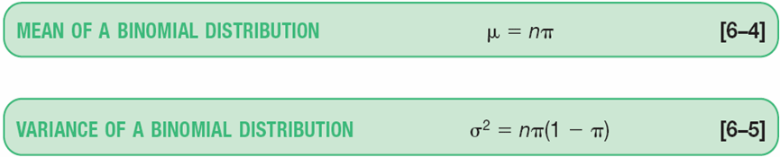
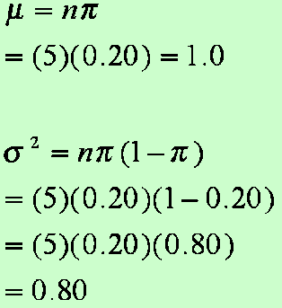
Binomial Probability Distribution
A Widely occurring discrete probability distribution
Characteristics of a Binomial Probability Distribution
There are only two possible outcomes on a particular trial of an experiment.
The outcomes are mutually exclusive,
The random variable is the result of counts.
Each trial is independent of any other trial
EXAMPLE
There are five flights daily from Pittsburgh via US Airways into the Bradford, Pennsylvania, Regional Airport. Suppose the probability that any flight arrives late is .20.
What is the probability that none of the flights are late today?
What is the average number of late flights? What is the variance of the number of late flights?
Notes:
‹#›

Slide 8
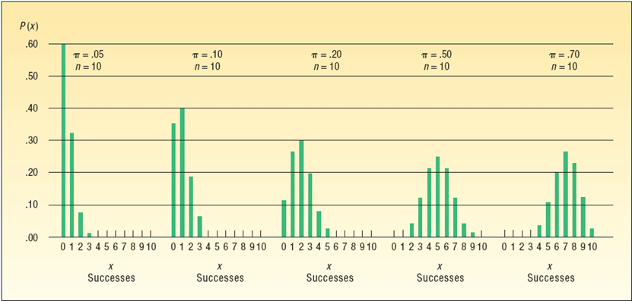
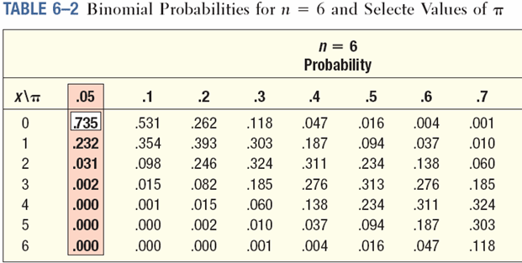
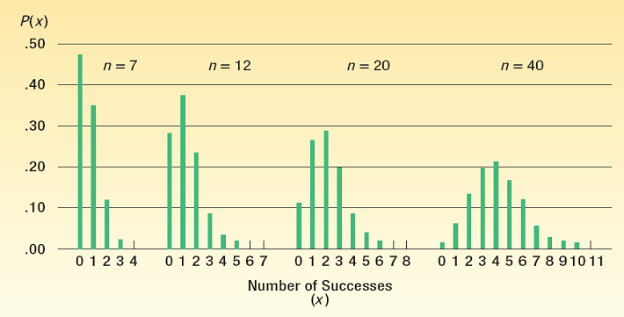
Binomial Distribution - Example
EXAMPLE
Five percent of the worm gears produced by an automatic, high-speed Carter-Bell milling machine are defective.
What is the probability that out of six gears selected at random none will be defective? Exactly one? Exactly two? Exactly three? Exactly four? Exactly five? Exactly six out of six?
Binomial – Shapes for Varying π (n constant)
Binomial – Shapes for Varying n (π constant)
Notes:
‹#›

Slide 9


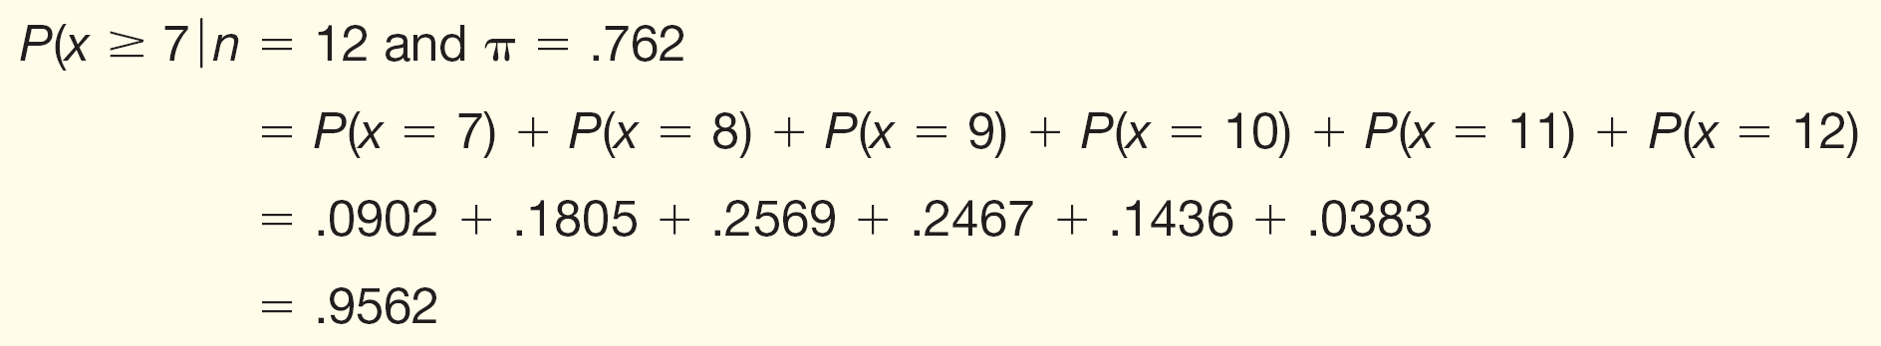
Cumulative Binomial Probability Distributions - Example
EXAMPLE
A study by the Illinois Department of Transportation concluded that 76.2 percent of front seat occupants used seat belts. A sample of 12 vehicles is selected.
What is the probability the front seat occupants in exactly 7 of the 12 vehicles are wearing seat belts?
What is the probability the front seat occupants in at least 7 of the 12 vehicles are wearing seat belts?
Notes:
‹#›

Slide 10
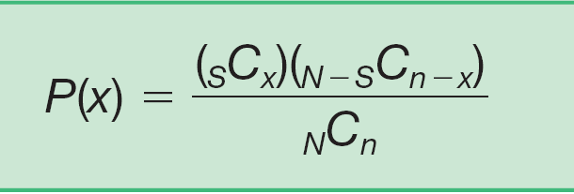
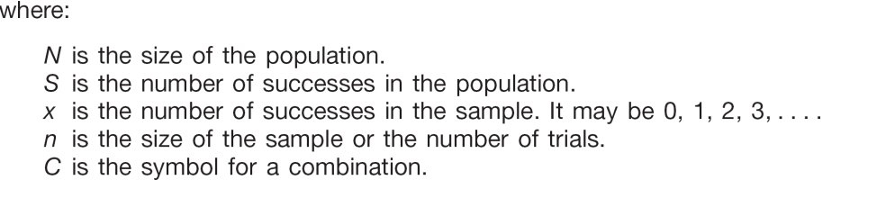

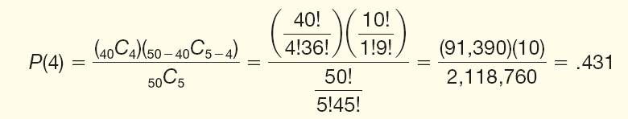
Hypergeometric Probability Distribution
1. An outcome on each trial of an experiment is classified into one of two mutually exclusive categories—a success or a failure.
2. The probability of success and failure changes from trial to trial.
3. The trials are not independent, meaning that the outcome of one trial affects the outcome of any other trial.
Note: Use hypergeometric distribution if experiment is binomial, but sampling is without replacement from a finite population where n/N is more than 0.05
Formula:
EXAMPLE
PlayTime Toys, Inc., employs 50 people in the Assembly Department. Forty of the employees belong to a union and ten do not. Five employees are selected at random to form a committee to meet with management regarding shift starting times.
What is the probability that four of the five selected for the committee belong to a union?
Here’s what’s given:
N = 50 (number of employees)
S = 40 (number of union employees)
x = 4 (number of union employees selected)
n = 5 (number of employees selected)
Notes:
‹#›

Slide 11
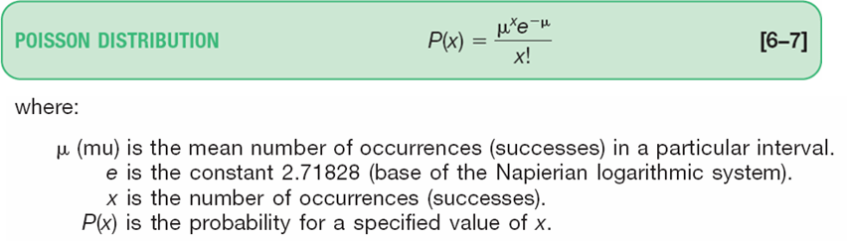
Poisson Probability Distribution
The Poisson probability distribution describes the number of times some event occurs during a specified interval. The interval may be time, distance, area, or volume.
Assumptions of the Poisson Distribution
The probability is proportional to the length of the interval.
The intervals are independent.
Examples include:
• The number of misspelled words per page in a newspaper.
• The number of calls per hour received by Dyson Vacuum Cleaner Company.
• The number of vehicles sold per day at Hyatt Buick GMC in Durham, North Carolina.
• The number of goals scored in a college soccer game.
Notes:
‹#›

Slide 12
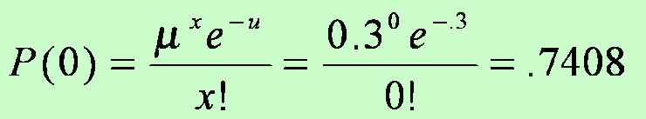
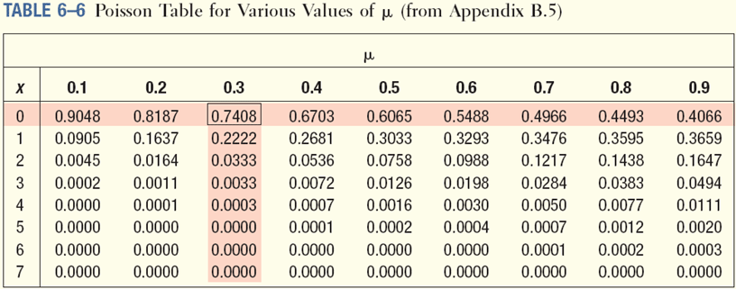
Poisson Probability Distribution - Example
EXAMPLE
Assume baggage is rarely lost by Northwest Airlines. Suppose a random sample of 1,000 flights shows a total of 300 bags were lost. Thus, the arithmetic mean number of lost bags per flight is 0.3 (300/1,000). If the number of lost bags per flight follows a Poisson distribution with u = 0.3, find the probability of not losing any bags.
.
Use Appendix B.5 to find the probability that no bags will be lost on a particular flight.
What is the probability exactly one bag will be lost on a particular flight?
Notes:
‹#›

Slide 13
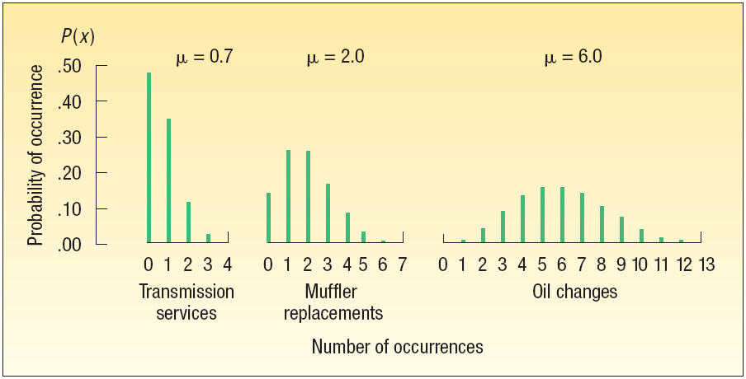
More About the Poisson Probability Distribution
The Poisson probability distribution is always positively skewed and the random variable has no specific upper limit.
The Poisson distribution for the lost bags illustration, where µ=0.3, is highly skewed.
As µ becomes larger, the Poisson distribution becomes more symmetrical.
Notes:
‹#›

